Slide 1
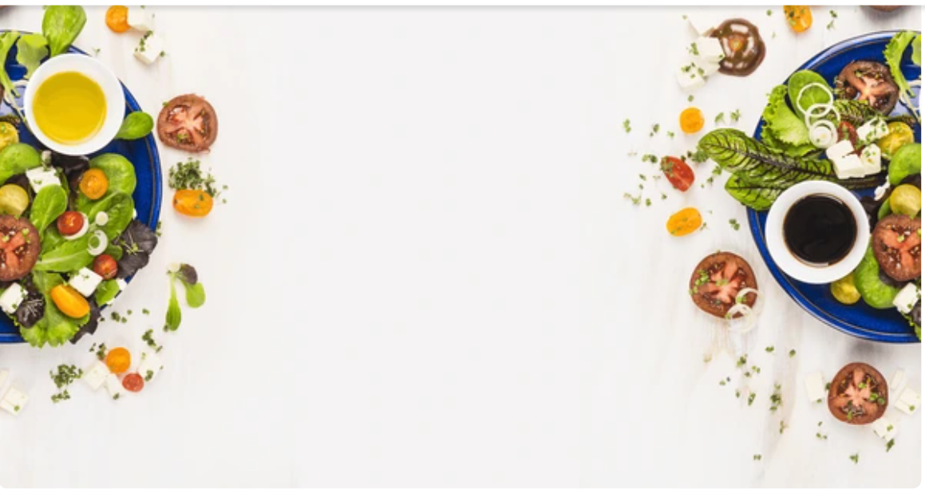

Subscription-Based E-Commerce Web Application
Team name: Hunters

Slide 2

Team members
Sagar Patil
Sanjyot Kotgire
Shruti Jha
Samiksha Wajage
Aamena Suzzanne
Write missin names
Sagar Patil
Sanjyot Kotgire
Shruti Jha
Samiksha Wajage
Aamena Suzzanne

Slide 3



Introduction
Our project is a web application that represents a subscription-based e-commerce platform. It is designed to streamline the process for customers to order and receive food products on a recurring basis. The platform offers convenience and flexibility by allowing customers to subscribe to regular deliveries of their essential food items, ensuring they never run out of what they need.
The primary goal of this project is to provide customers with a hassle-free way to receive food products through various subscription plans.
Add details about prgt scope

Slide 4
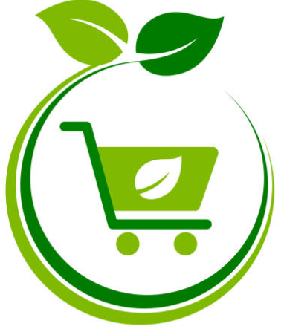
Features
Subscription Plans:
Customers can choose from various subscription plans that offer discounts compared to one-time purchases.
Flexibility to customize delivery schedules according to their needs.
Wide Range of Food Products:
Access to a diverse selection of food products, including organic fruits, vegetables, snacks, and ready-to-eat meals.
Detailed product information and images available for each item.
Manage Orders and Subscriptions:
Customers can easily manage their subscriptions, view their order history, and make changes to their plans as needed.
Option to pause, modify, or cancel subscriptions at any time.
User-Friendly Interface:
Intuitive and easy-to-navigate interface for browsing products, subscribing, and managing accounts.
Secure payment processing for seamless transactions.

Slide 5
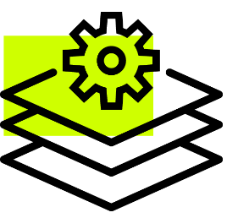
Technologies Used:
HTML, CSS, JS, Java, SQL,
Java
Design Patterns, SOLID Principles).

Slide 6

Learnings
Technologies: Summarize what you learned about HTML, CSS, JS, Java, etc.
Design & Principles: Discuss the importance of design patterns and SOLID principles.
Teamwork: Reflect on the experience of working as a team.

Slide 7
results
Screenshots of website

Slide 9
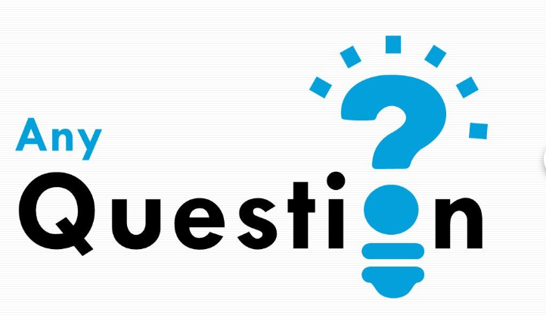

Slide 10
